Slide 1
Lecture 1
Antenna Basics

Slide 2
What is antenna?
Radiation patterns
Polarizations
Directivity and gain
Friis transmission equation
Radar equation

Slide 3
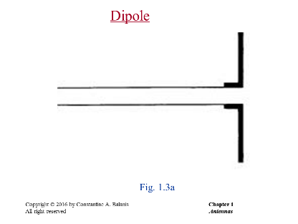
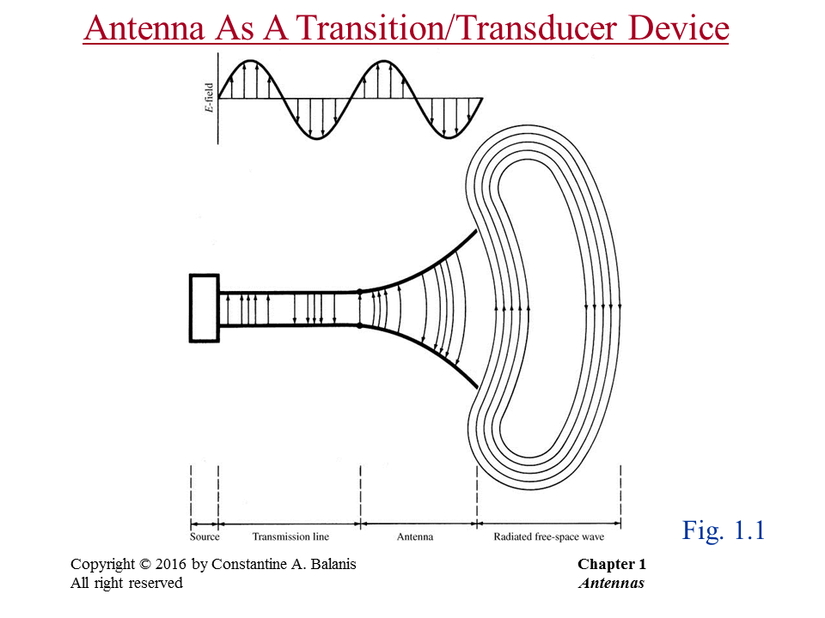
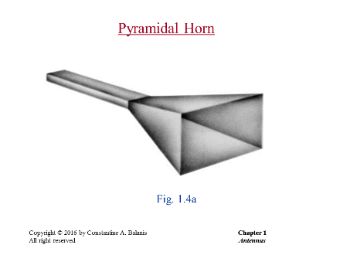
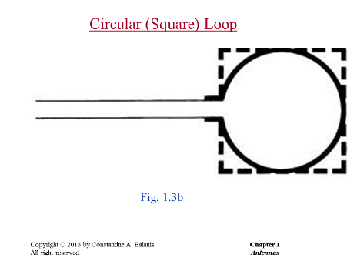
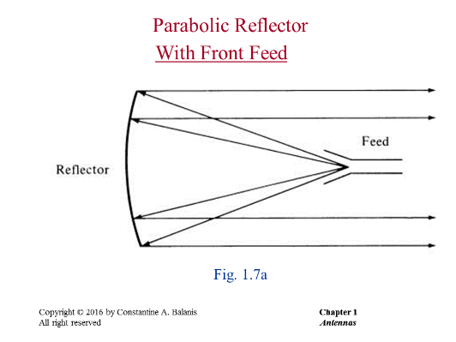
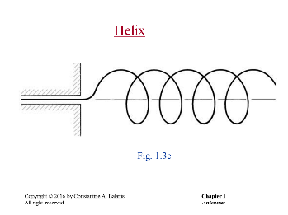
An Antenna is a passive, linear device which translates a bounded wave into an un-bounded wave. This device could be made of wires (dipoles, slots, helical antennas, etc.) or apertures (horns, reflectors, etc.). The role of the antenna designers is to generate the correct radiation patterns, polarizations, input impedances and bandwidths by using different geometries.

Slide 4

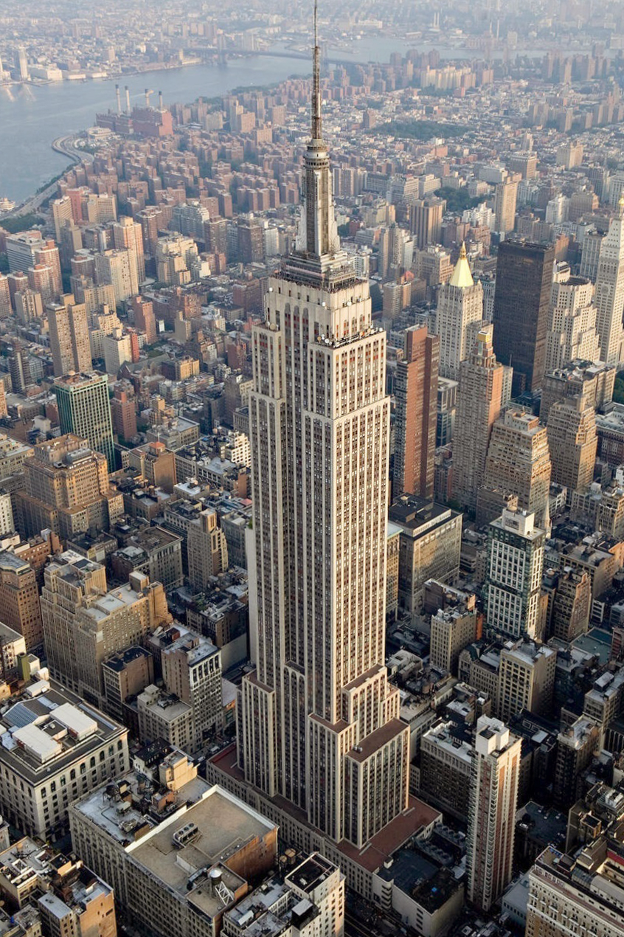
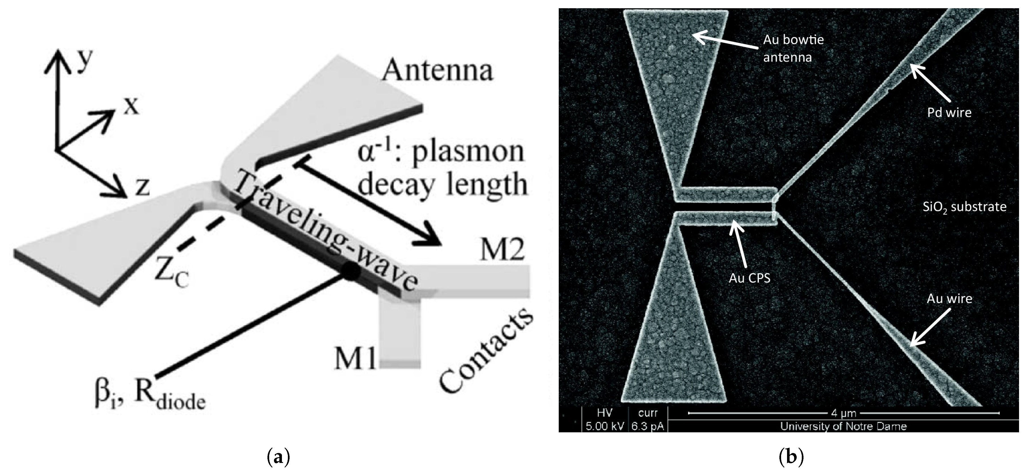
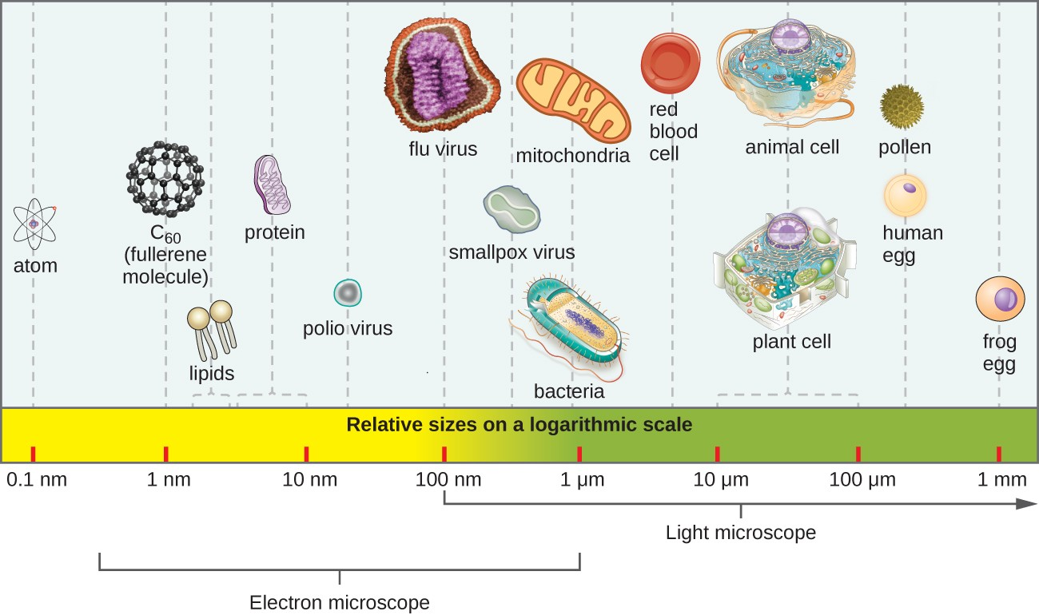
Five-Hundred-Meter Aperture Spherical Radio Telescope (FAST) in China
8 orders of magnitude difference!
M. Mubarak et al, “Nano-Antenna Coupled Infrared Detector Design”, Sensors, 2018

Slide 5
Radiation Patterns

Slide 6
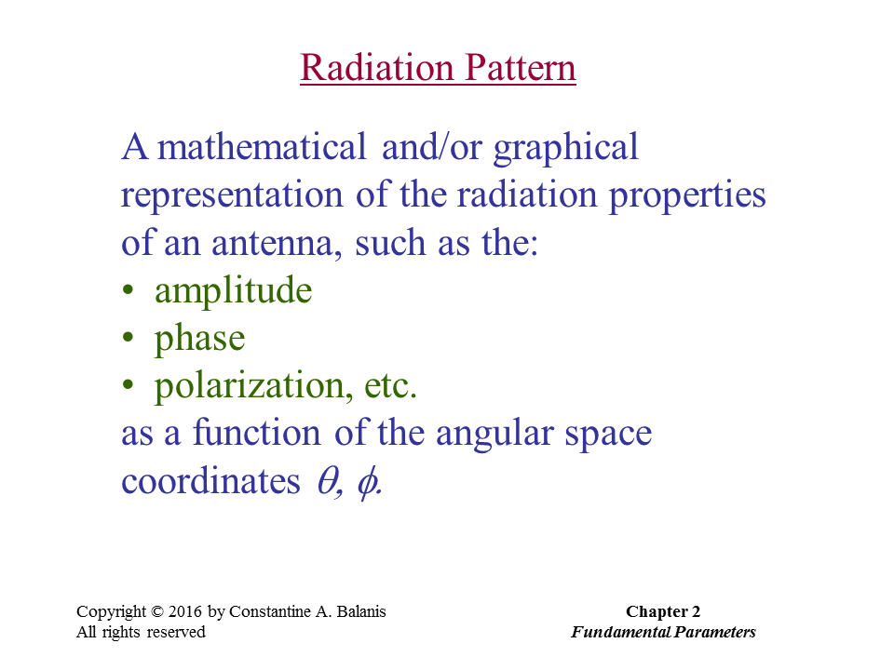

Slide 7
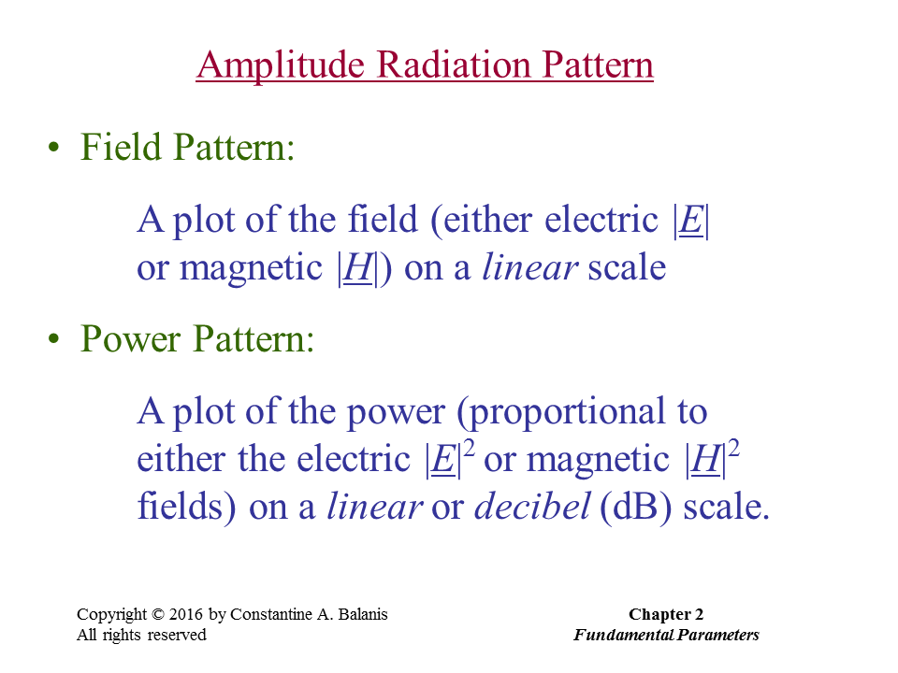

Slide 8
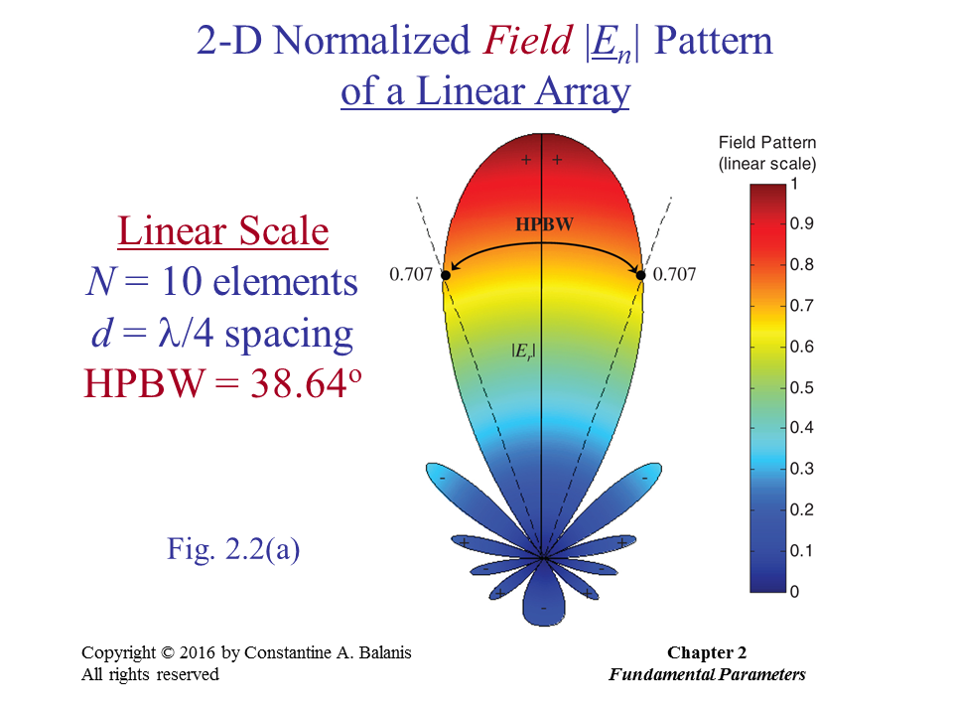

Slide 9
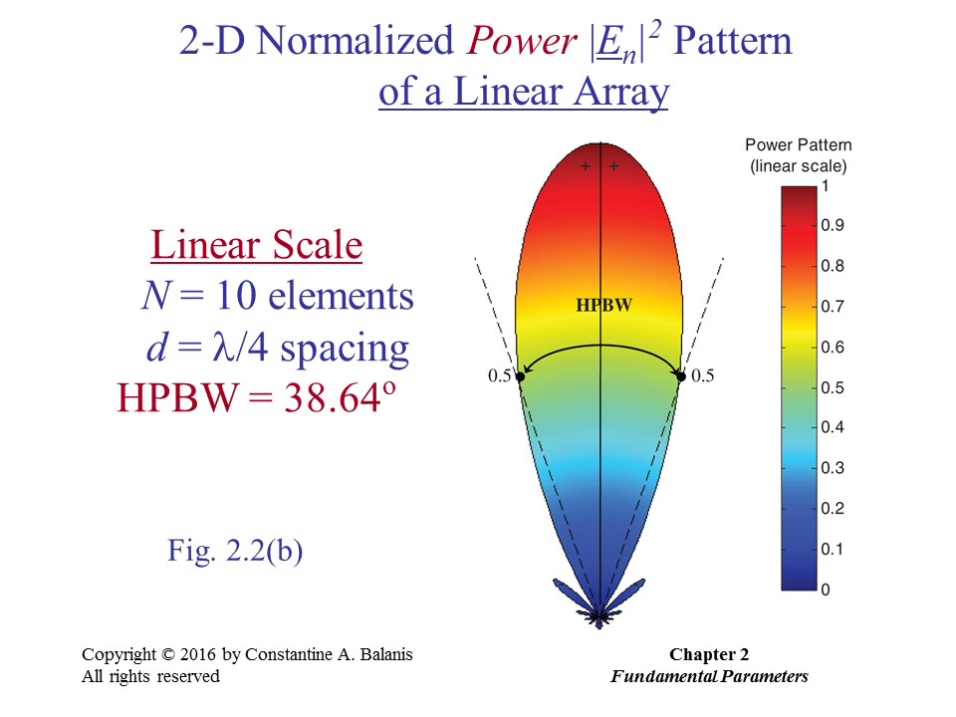

Slide 10
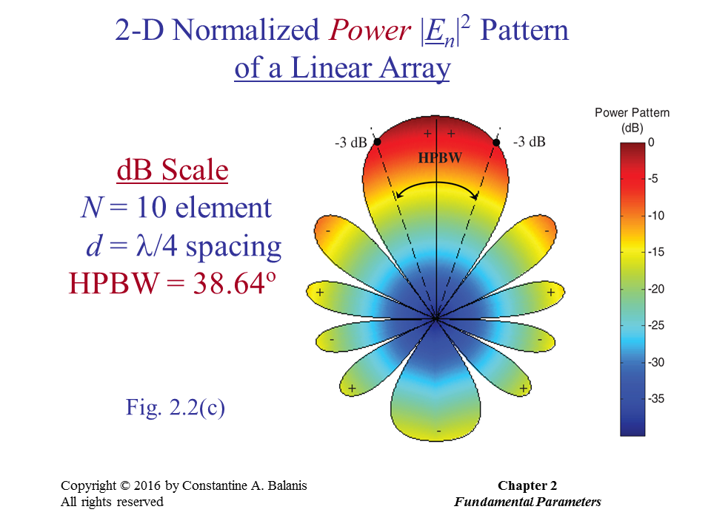

Slide 11
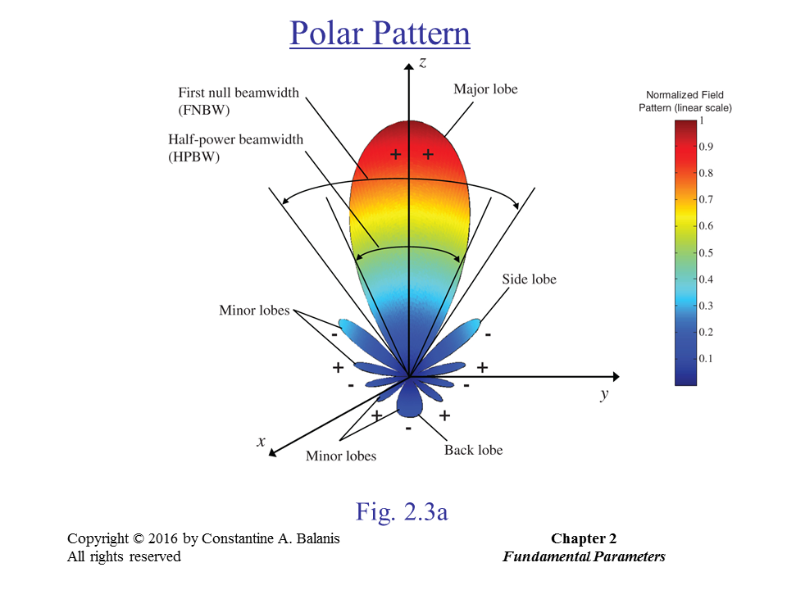

Slide 12
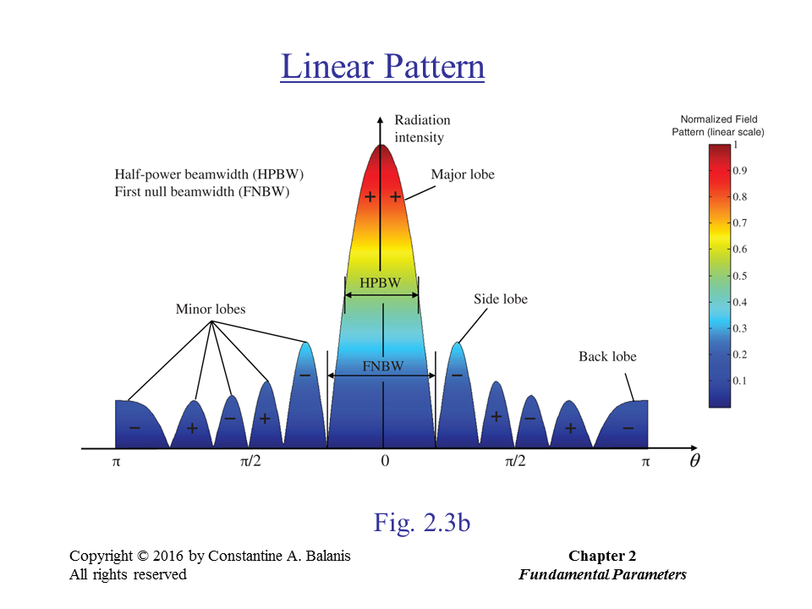

Slide 13
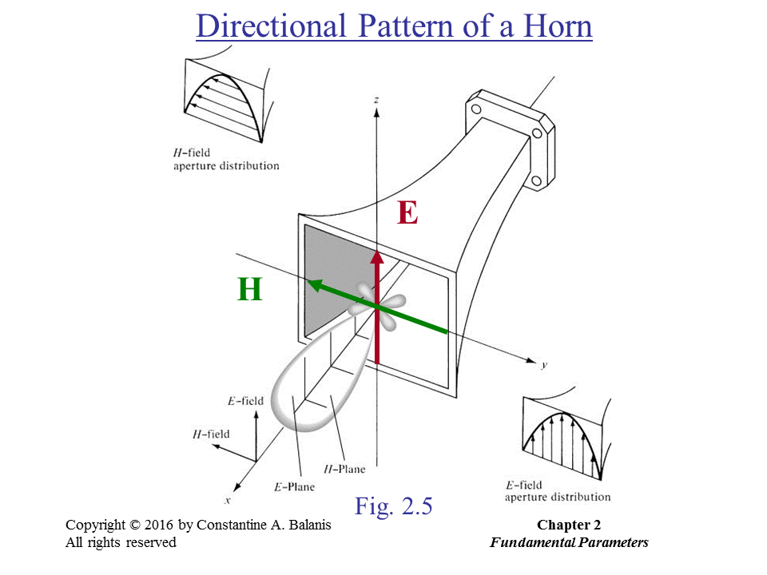

Slide 14
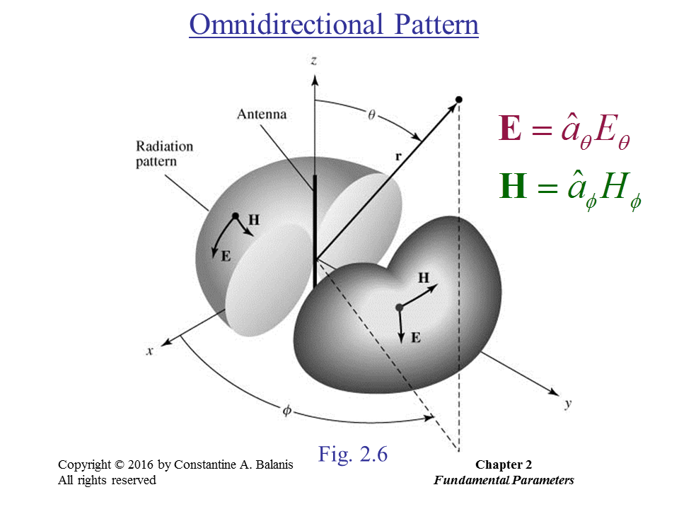

Slide 15
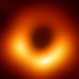
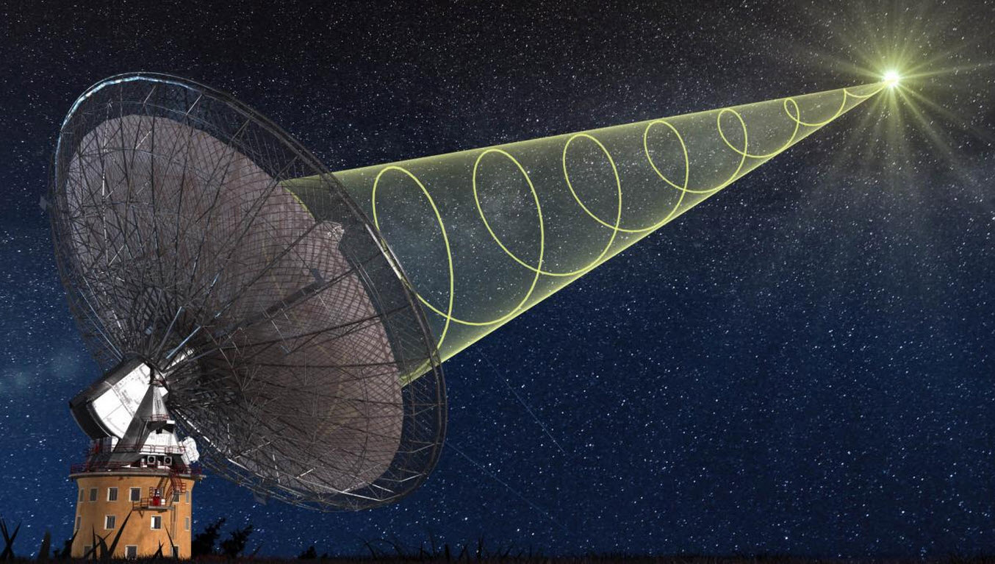
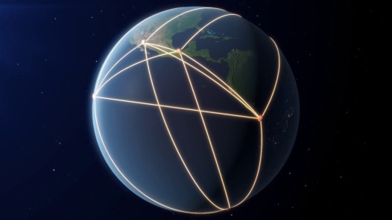
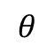
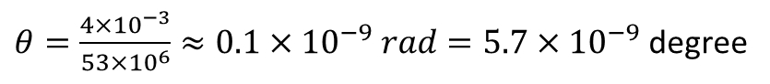
Black hole @ M87
HPBW=50.8º/(L/λ) = 5×10⁻⁹ degree
f = 230 GHz
λ = 1.3 mm
38 billion km
≈ 4×10⁻³ ly
53 million ly
2D²/λ = 27 ly
Event Horizon Telescope
$θ=\frac{4×{10}^{−3}}{53×{10}^{6}}≈0.1×{10}^{−9} rad=5.7×{10}^{−9}$ degree
$$θ$$
4×10⁻³ ly
13,000 km
53 million ly

Slide 16
Polarizations

Slide 17
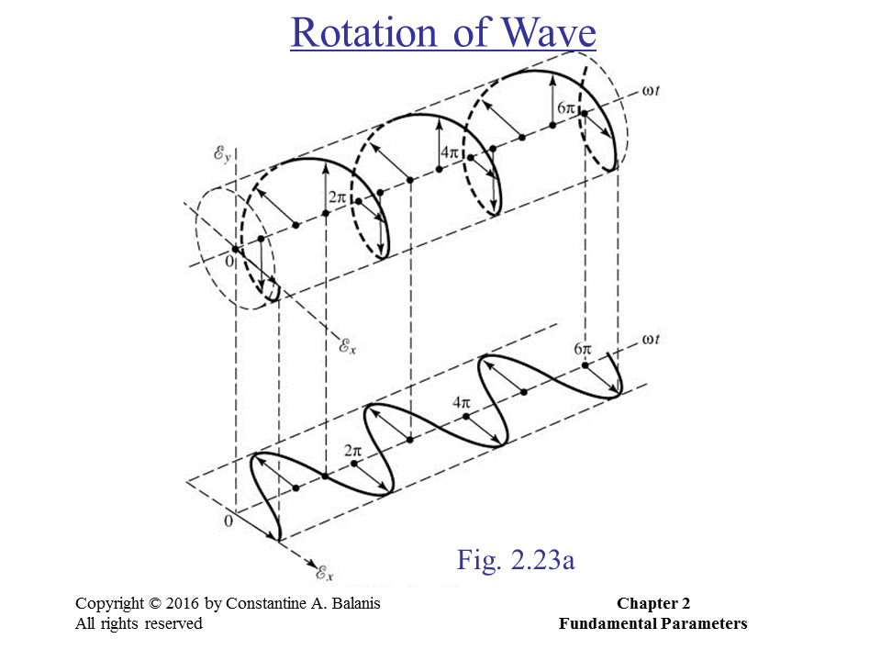

Slide 18
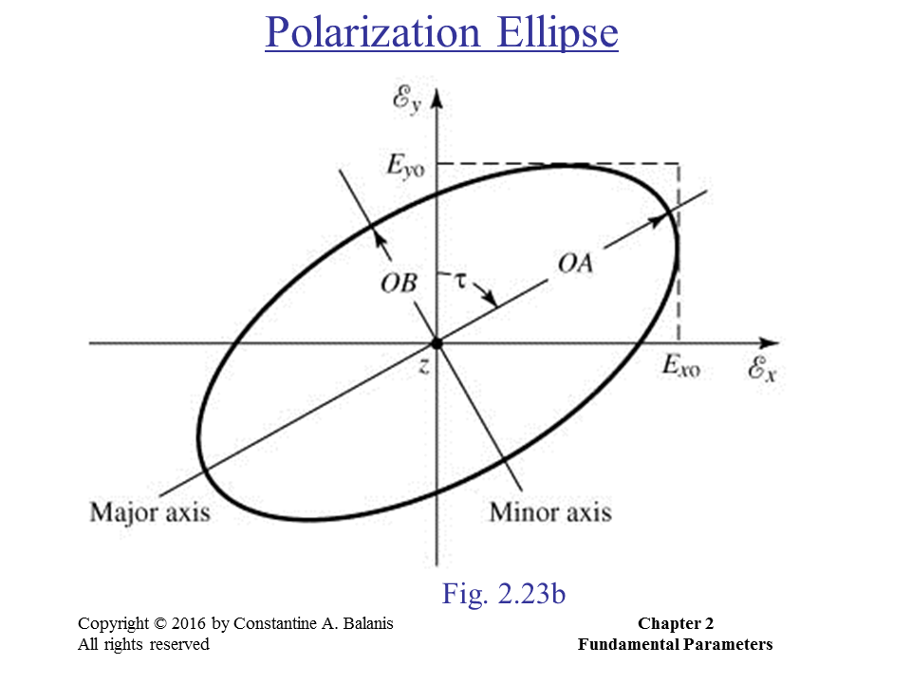

Slide 19
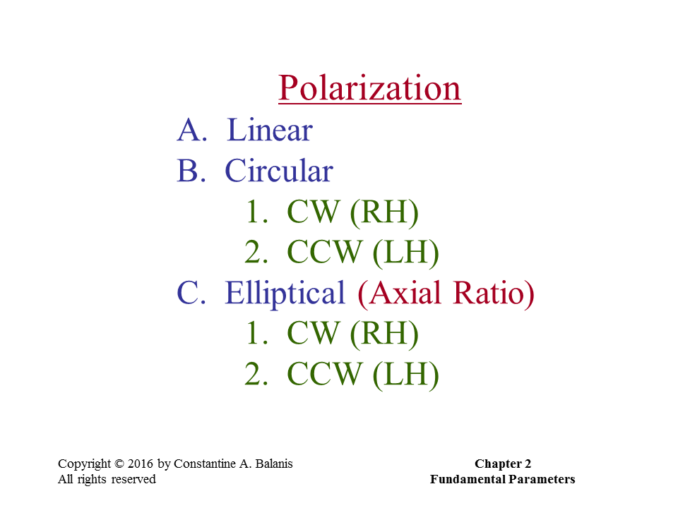
Assumption here: The wave is propagating along –z direction.

Slide 20
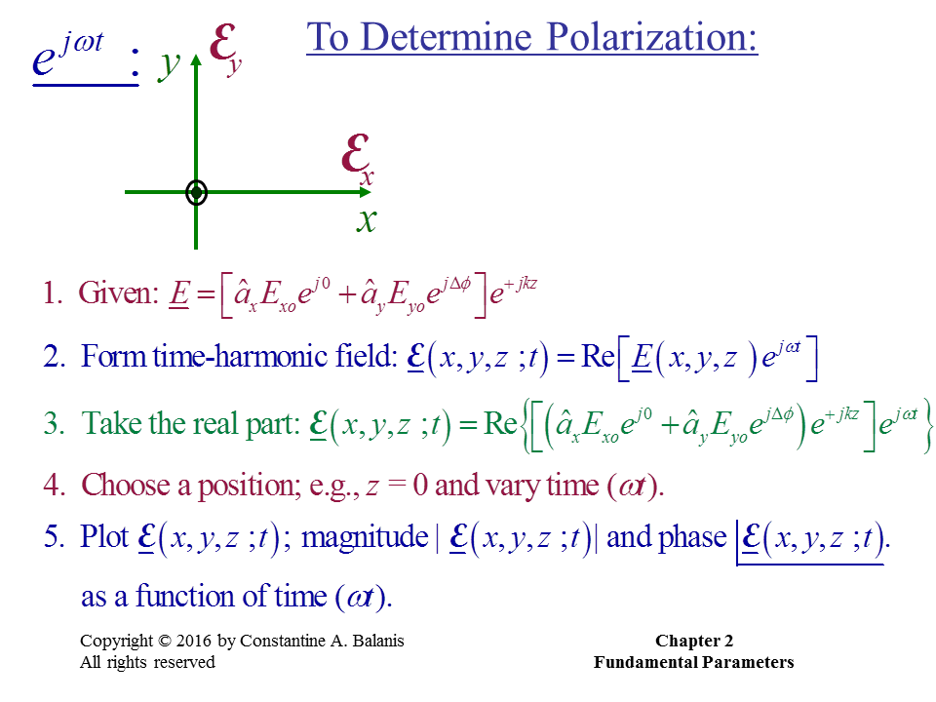

Slide 21
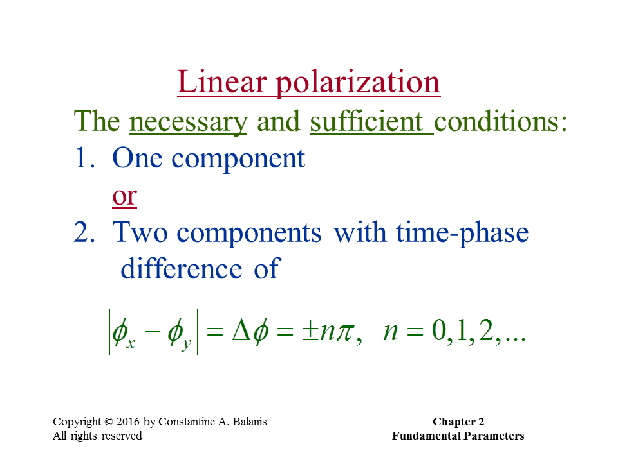

Slide 22
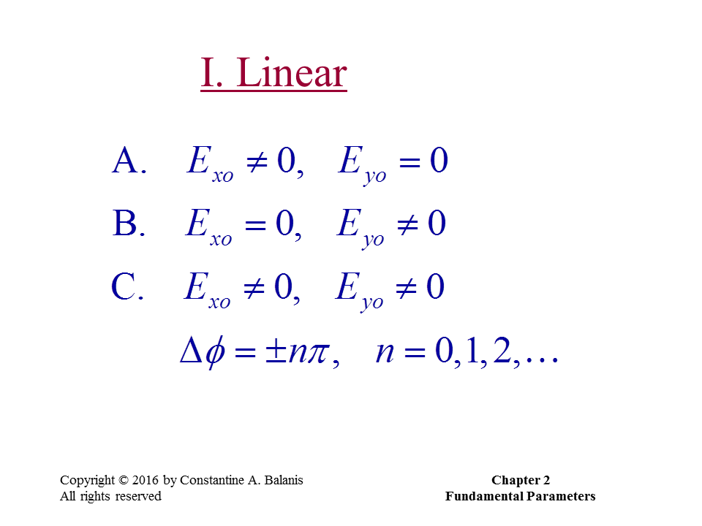

Slide 23
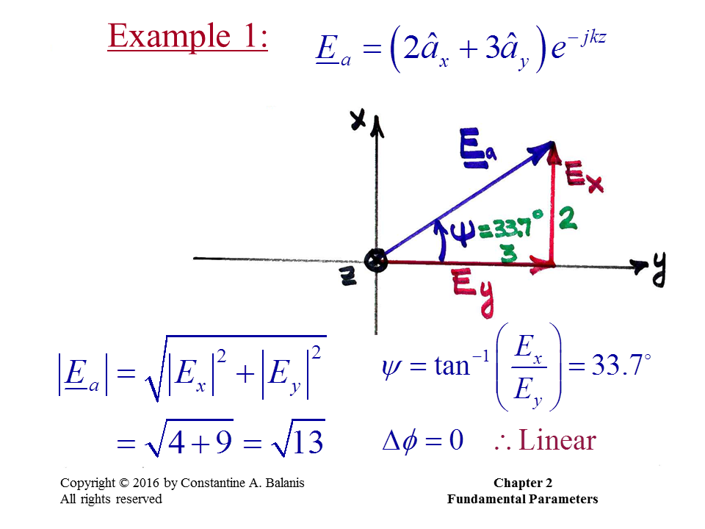

Slide 24
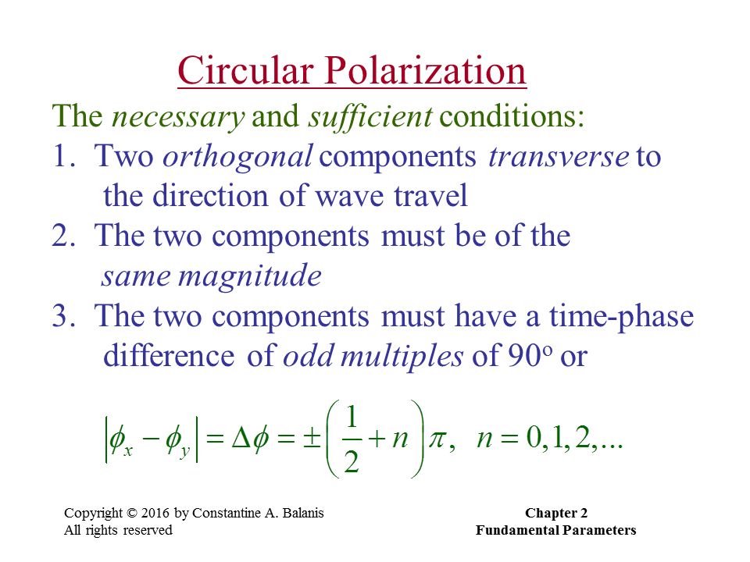

Slide 25
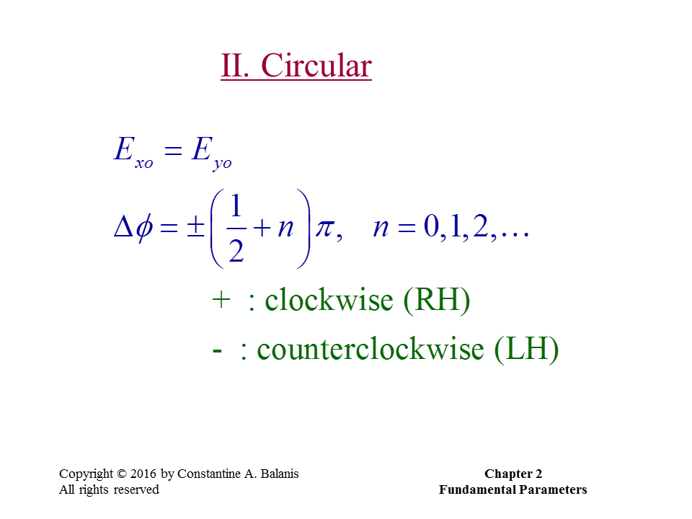

Slide 26
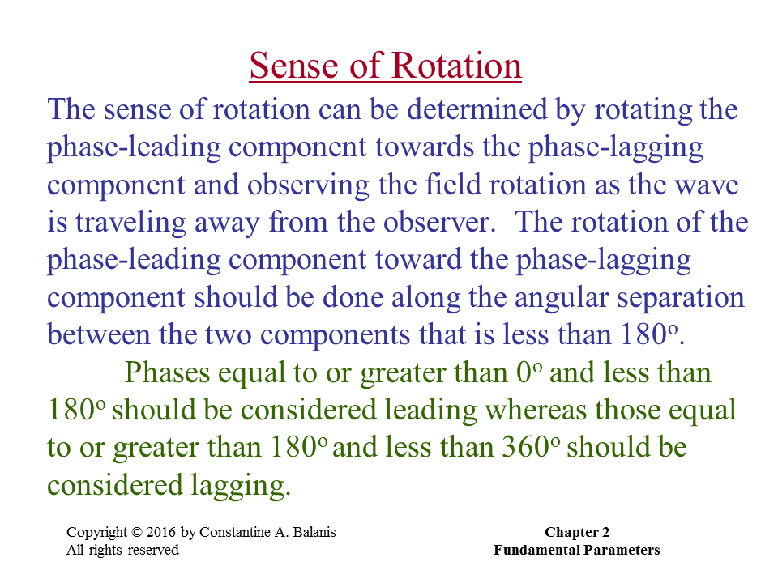

Slide 27
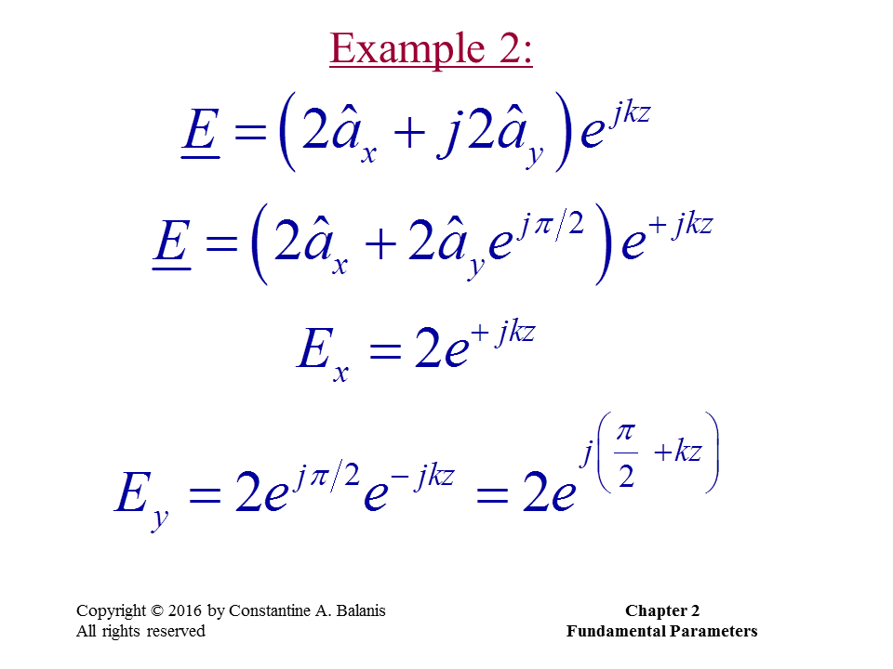

Slide 28
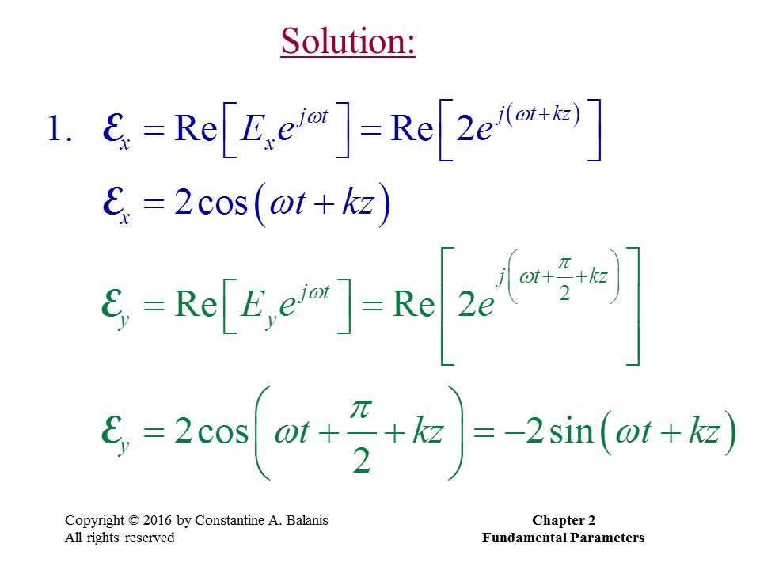

Slide 29
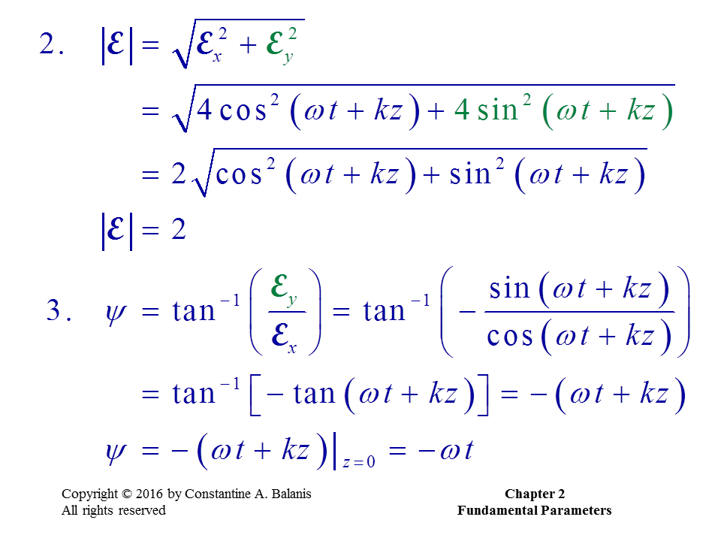

Slide 30
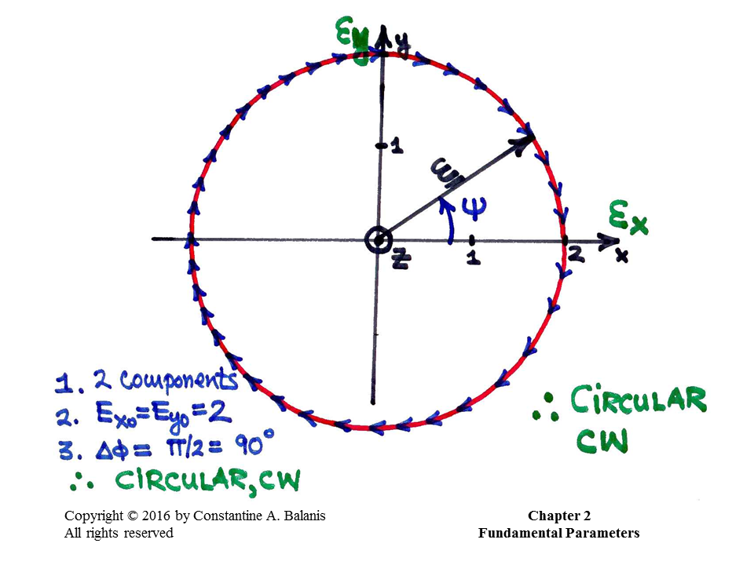

Slide 31
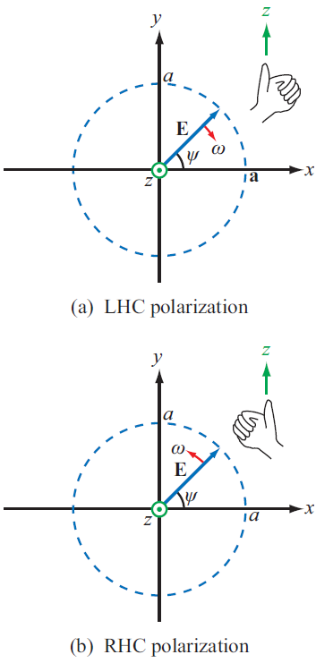
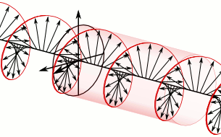
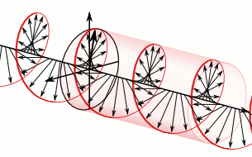
LHCP or RHCP
When δ = -90º and |E_{x0}|= |E_{y0}|
When δ = 90º and |E_{x0}|= |E_{y0}|
RHCP
LHCP

Slide 32
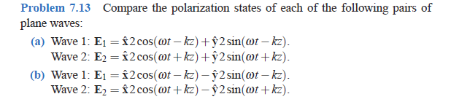
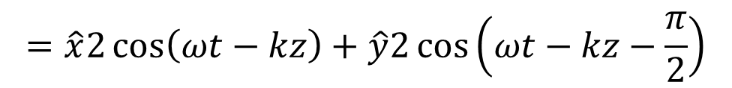
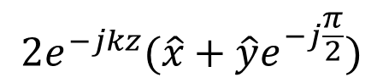
Example: How to Judge RHCP or LHCP
$$=\hat{x}2\cos\left(ωt−kz\right)+\hat{y}2\cos\left(ωt−kz−\frac{π}{2}\right)$$
Time Domain
$$2e^{−jkz}(\hat{x}+\hat{y}e^{−j\frac{π}{2}})$$
Phasor Domain
z
k
k
-90º
y
0º
RHCP
x

Slide 33
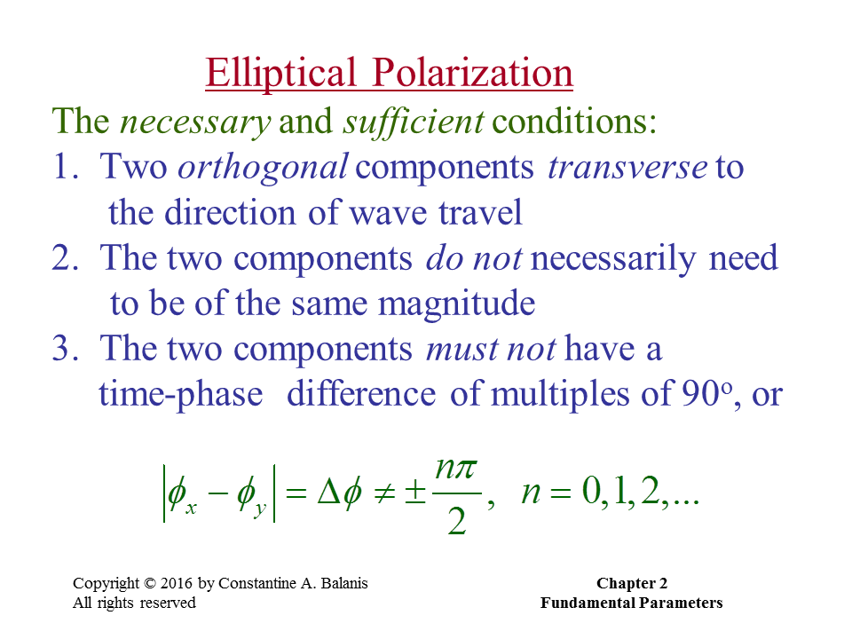

Slide 34
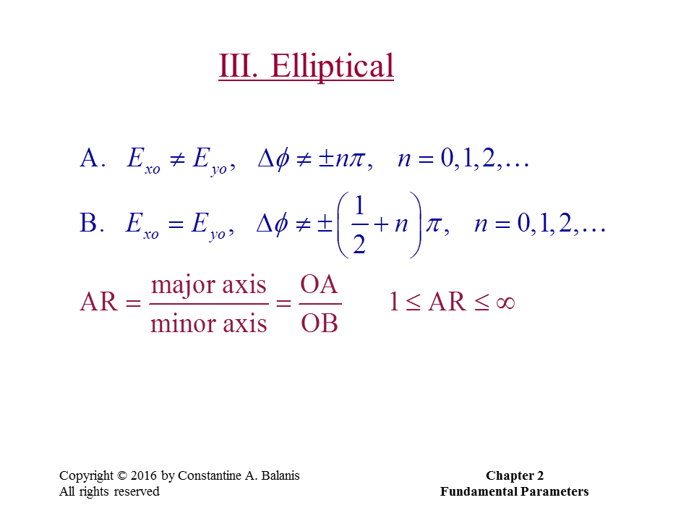

Slide 35
Directivity and Gain

Slide 36
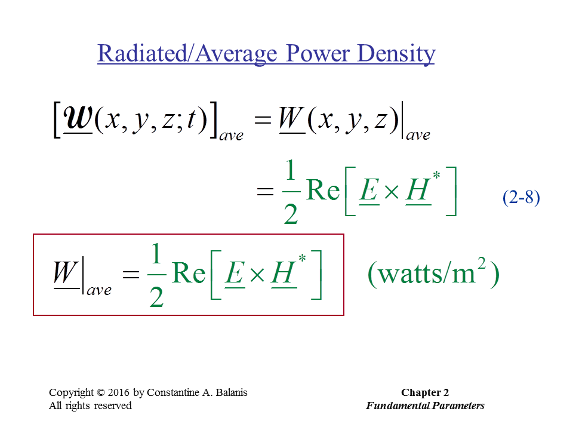

Slide 37
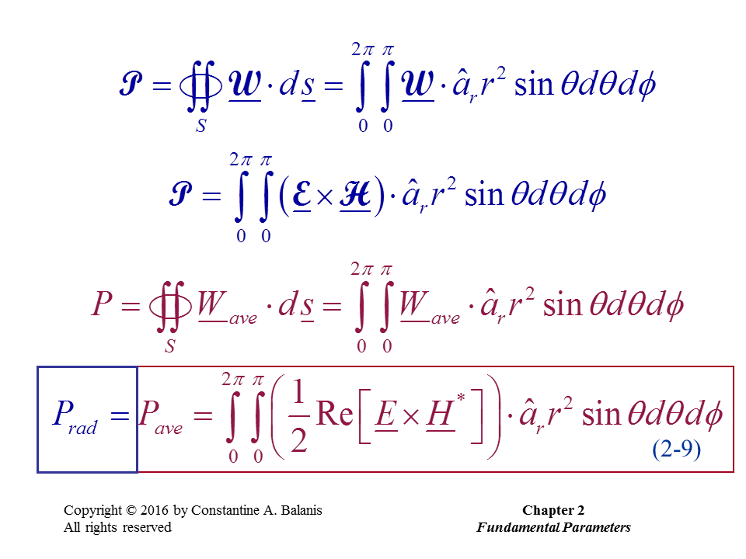

Slide 38
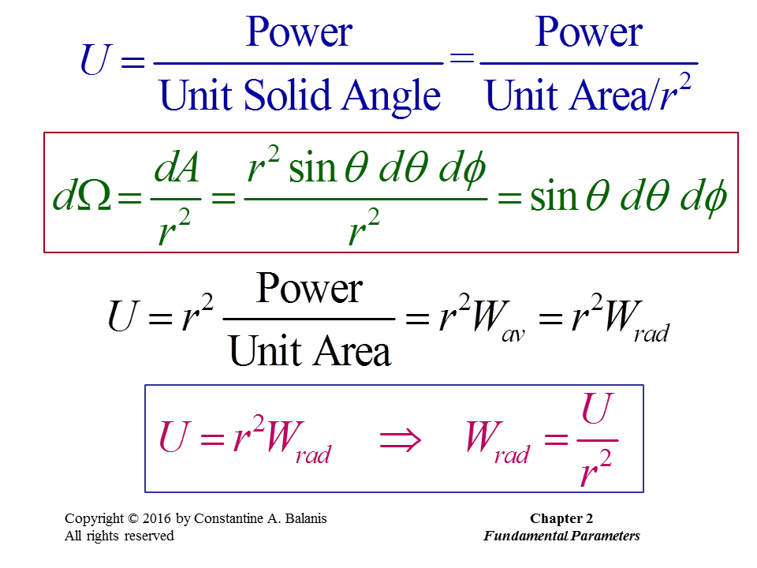
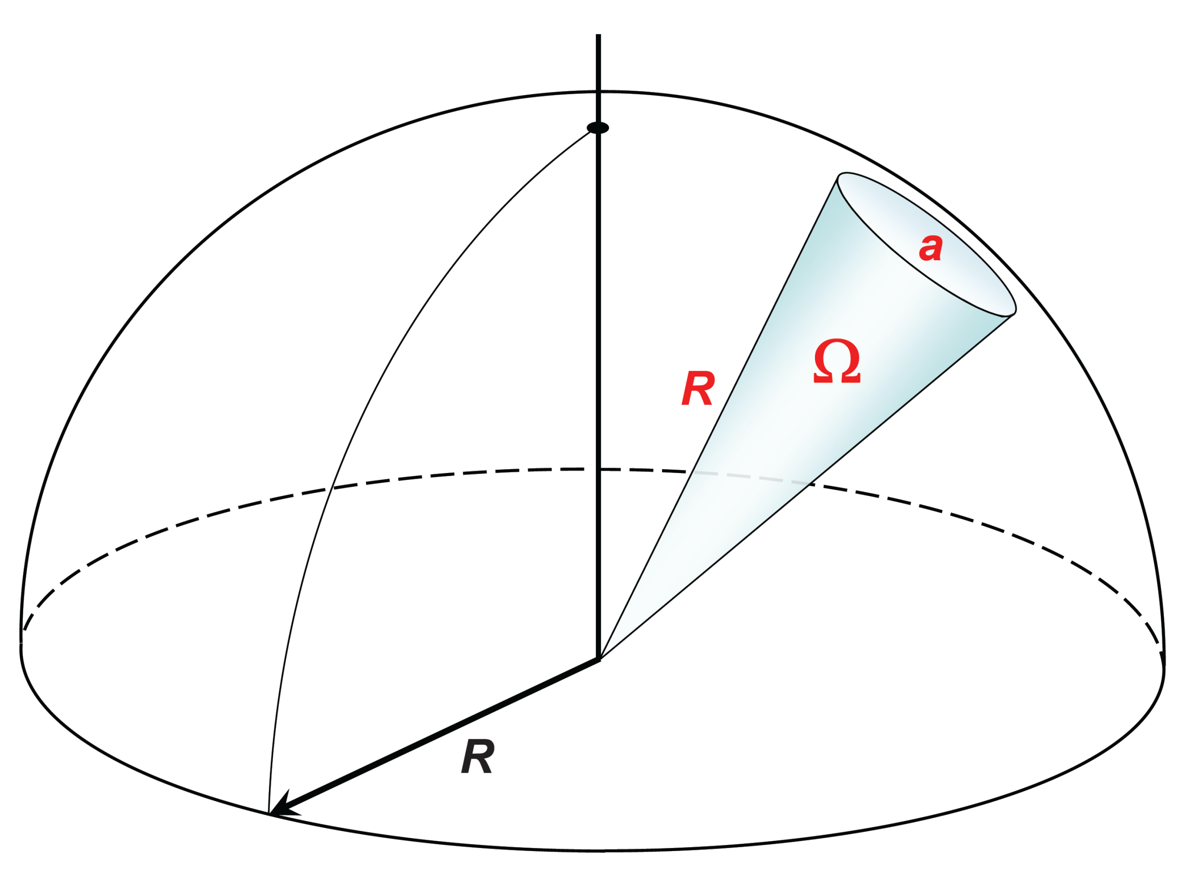

Slide 39
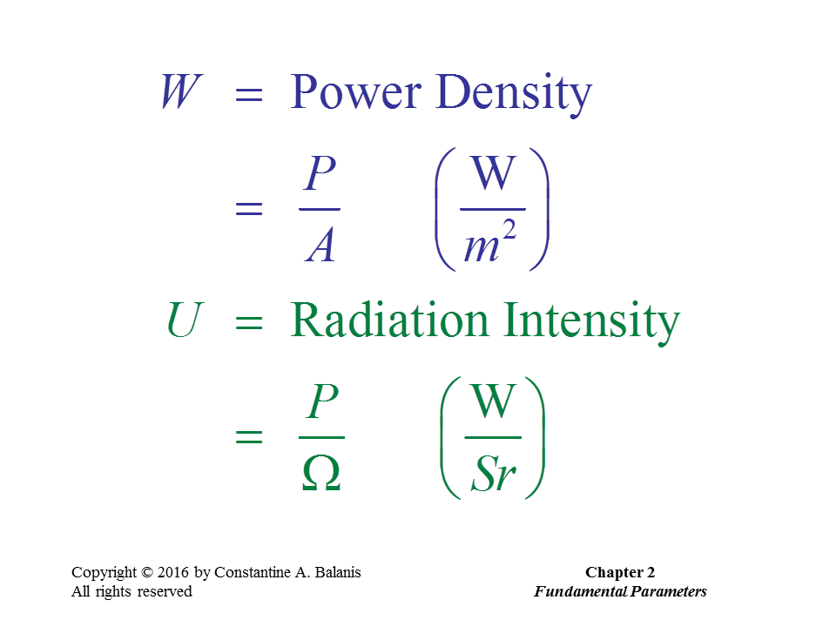

Slide 40


Slide 41

The unit for Directivity should be dBi (dB over an isotropic radiator)

Slide 42


Slide 43


Slide 44


Slide 45



Slide 46


Slide 47
Friis Transmission Equation

Slide 48



Slide 49


Slide 50


Slide 51


Slide 52

We will derive the effective area later

Slide 53
Radar Equation

Slide 54


Slide 55


Slide 56


